Slide 1

Introduction to the MOSS
(Mini one stop shop)
VAT Department
3rd September 2014
MINISTRY FOR FINANCE
VAT Department, Centre Point Building,
16, Ta’ Paris Road, Birkirkara, Malta

Slide 2
INTRODUCTION TO MOSS
As of 1st January 2015, the place of supply of telecommunications, broadcasting and electronically supplied services shall be the place of the customer
This means that, Maltese operators would be required to account for and charge the tax of the Member States where their customers are established which could be a compliance burden if the supplier as customers established in different Member States
Operators have two options for complying with this legal obligation:
1. Register and comply with the VAT rules of all the Member States where their customers would be located, potentially 27 different ones; or
2. Register under the MINI One Stop Shop (MOSS) which is a simplification measure which the EU Commission proposed to facilitate compliance.
MINISTRY FOR FINANCE
VAT Department, Centre Point Building,
16, Ta’ Paris Road, Birkirkara, Malta

Slide 3
MOSS – a simplification scheme
  The scheme is applicable to taxable persons who make B2C supplies of TBES (telecommunications, broadcasting and electronically supplied services) in MSs other than that in which they are established.
  The MOSS mechanism is operated through an electronic portal where one
    Applies for Registration
    Submits the Return
    Makes the Payment
at a Single point instead of having to register for VAT in all the MSs where his customers are established.
MINISTRY FOR FINANCE
VAT Department, Centre Point Building,
16, Ta’ Paris Road, Birkirkara, Malta

Slide 4
MOSS – terms
      TBES = Telecommunications, Broadcasting and Electronically supplied services
    MSI = Member State of Identification
    MSC = Member State of Consumption
    MSE = Member State of Establishment
    Fixed Establishment = business (Branch) established in a MS other than the MS in which the business is established (Headquarters)
MINISTRY FOR FINANCE
VAT Department, Centre Point Building,
16, Ta’ Paris Road, Birkirkara, Malta

Slide 5
Main principles of MOSS (1)
One single place of registration:
  Non-EU scheme: choice of the MS of identification
  EU scheme:
in the MS where the business is established
- in case of a non-EU business with an establishment in the EU, where the business has that fixed establishment (choice if several).
Registrations can be submitted as of the 1st of October 2014.
MINISTRY FOR FINANCE
VAT Department, Centre Point Building,
16, Ta’ Paris Road, Birkirkara, Malta

Slide 6
Main principles of MOSS (2)
Allocation of a unique registration number with which the taxable person shall be identified for MOSS purposes only in the case of non EU Scheme
EU Scheme - VAT Number will also be identified for MOSS purposes
The Mini One Stop Shop cannot be used in the Member State of establishment, (local supplies). Declaration must be made through the domestic VAT return.
The Mini One Stop Shop does not include the deduction of input VAT
    Domestic VAT return or
    electronic refund procedure under Council Directive 2008/9/EC
    the 13th Directive (Council Directive 86/560/EEC) for the non-EU Scheme.
MINISTRY FOR FINANCE
VAT Department, Centre Point Building,
16, Ta’ Paris Road, Birkirkara, Malta

Slide 7
Main principles of MOSS (3)
Exclusions from the MOSS:
  Voluntarily opt out
  Cessation of relevant activities
  No longer meets the necessary conditions
  Persistent non-compliance with the rules
Only the MSI can take the decision of exclusion.
Quarantines (period before re-registration) in some cases
When not registered under the MOSS the normal VAT rules will apply
MINISTRY FOR FINANCE
VAT Department, Centre Point Building,
16, Ta’ Paris Road, Birkirkara, Malta

Slide 8
Main principles of MOSS (4)
One single standardised declaration in all MS
Declaration in the Maltese Portal in Euro
Payment to be made through a bank transfer
Corrections possible within 3 years on the portal.
All MSs share registration and return information on operators registered under the MOSS Scheme
MINISTRY FOR FINANCE
VAT Department, Centre Point Building,
16, Ta’ Paris Road, Birkirkara, Malta

Slide 9
Main principles of MOSS (5)
Mini One Stop Shop Return
One single declaration
Multi-rate, multi-country
No declaration of exempt supplies
Standardised
MINISTRY FOR FINANCE
VAT Department, Centre Point Building,
16, Ta’ Paris Road, Birkirkara, Malta

Slide 10
Main principles of MOSS (6)
Records must be kept for 10 years.
Standardised list of records to be kept as per Council Regulation 967/2012 (article 63c)
Controls and audits:
  Responsibility of MSs of consumption
  Coordination by MS of identification in most cases
MINISTRY FOR FINANCE
VAT Department, Centre Point Building,
16, Ta’ Paris Road, Birkirkara, Malta

Slide 11
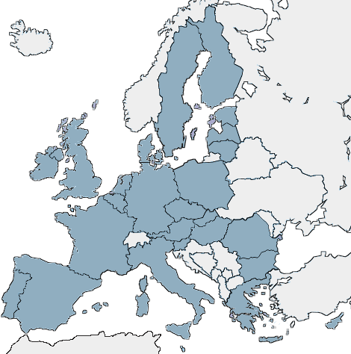
Mini One Stop Shop – the EU Scheme
Typical Scenario
MT Established business or MT Fixed Establishment of a Business based in the US
Not established in FR or DE.
Supplies electronic services (e.g. software) to private customers in FR and DE
VAT rate of FR and DE
Registration for VAT through the MOSS
in MT
Returns and payments in MT
Transfer of information / funds to
FR and DE.
Malta
MINISTRY FOR FINANCE
VAT Department, Centre Point Building,
16, Ta’ Paris Road, Birkirkara, Malta

Slide 12
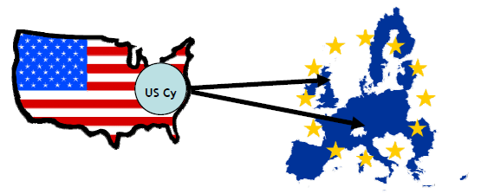
Mini One Stop Shop – non EU Scheme
Typical Scenario
US business not established and not having a fixed establishment in any EU Member State
Supplies electronic services (e.g. software) to private customers in MT, DE and UK
VAT rate of MT, DE and UK
Registration for VAT through the MOSS in MT, DE or UK or any other MS (MS of identification to be chosen by the Supplier).
Returns and payments in this MS of identification
Transfer of information to all MSs of consumption.
MINISTRY FOR FINANCE
VAT Department, Centre Point Building,
16, Ta’ Paris Road, Birkirkara, Malta

Slide 13
Other information
One Stop Shop practical guidelines developed by the Commission in cooperation with MSs can be accessed from the EU Commission website:-
http://ec.europa.eu/taxation_customs/taxation/vat/how_vat_works/telecom/index_en.htm#one_stop
Guidelines not legally binding
The following EU legislation applies:
Council Directive 2006/112/EC, as amended by Directive 2008/8/EC
Council Regulation (EU) No 904/2010 on administrative cooperation and combating fraud in the field of value added tax (recast)
Council Implementing Regulation (EU) No 282/2011 on the place of supply of services, as amended by Implementing Regulations 967/2012 and 1042/2013
Commission Implementing Regulation (EU) No 815/2012 laying down detailed rules for the application of Council regulation (EU) No 904/201-. As regards special schemes for non-established persons supplying telecommunications, broadcasting or electronic services to non-taxable persons.
MINISTRY FOR FINANCE
VAT Department, Centre Point Building,
16, Ta’ Paris Road, Birkirkara, Malta

Slide 14
Thank You
MINISTRY FOR FINANCE
VAT Department, Centre Point Building,
16, Ta’ Paris Road, Birkirkara, Malta

